Slide 1
HTML5 and CSS3
Getting Started with HTML

Slide 2
Some basic terms to get us started
Definitions:
The World Wide Web
The set of computers on the Internet that support HHTP
HTTP
The HyperText Transfer Protocol
The language used by the WWW client (IE or Chrome) to request downloads from a WWW server
HTML
The HyperText Markup Language
The language used to design web pages

Slide 3
What is HTML ?
Again, HTML stands for Hypertext Markup Language (HTML) and was developed by researchers at CERN (European Organization for Nuclear Research) in the early 1990s
A markup language is simply a set of rules that defines the layout, format, or structure of text within a document
After markup instructions are added to a document, the document must be read, or processed, by a program that knows how to interpret the markup elements …… enter the Web Browser

Slide 4
Brief History of HTML
HTML 1.0 (1993)
HTML 2.0 (1995)
at that time Netscape Navigator offered much more functionality than the HTML standard
- "browser war" between Netscape and Internet Explorer
HTML 3.2 (1997)
first version that was developed exclusively by the Word Wide Web Consortium (W3C)
introduced tables
introduced a lot of new elements for the visual appearance of a document
attempt to restrain the browser wars

Slide 5
Brief History of HTML
HTML 4.0 (1997) and HTML 4.01 (1999)
internationalisation (Unicode)
introduction of Cascading Style Sheets (CSS)
In 1998 the W3C decided to not further evolve HTML!
XHTML 1 (2000) and XHTML 1.1 (2001)
XML version of HTML
XHTML 2.0 (never finished, discontinued in 2009)
revolutionary changes
breaking backwards compatibility
Web Hypertext Application Technology Working Group (WHATWG) founded in 2004 (led by Ian Hickson) began work on Web Applications 1.0 which would eventually become HTML5

Slide 6
Brief History of HTML
In 2006 the W3C decided to work on HTML again based on WHATWG's Web Applications specification
HTML5 specification is currently developed simultaneously by the WHATWG and the W3C
HTML Working Group (broke apart in 2011)
HTML – Living Standard, WHATWG
HTML5 – Focus on HTML and XHTML, W3C designated HTML5 as a Candidate Recommendation in Dec 2012 with a call for recommendation in 2014

Slide 7
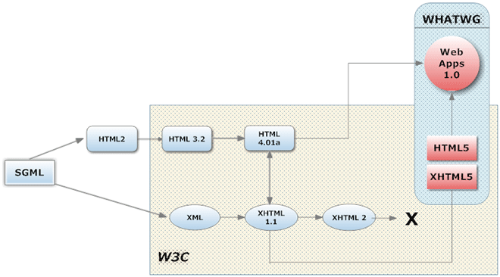
Brief History of HTML

Slide 8
Inside HTML5
HTML5 is supported* in all modern browsers.
HTML5 has been created in a way to make it backward compatible with earlier versions of HTML and XHTML
HTML5 also tells the browser how it should handle errors caused by incorrect markup implementations. Previously, browsers would interpret the errors themselves, and each browser would have its own quirks
The true power of HTML5, as we will see further into the course, is how it addresses the needs for web application developers. Because browsers are so powerful, websites can be created that are very much like applications. They can provide photo sharing, drawing, file editing, and other features

Slide 9
Previously, these types of features required layers of JavaScript and a plug-in such as Java or Flash
This causes accessibility issues and relies heavily on the stability of third-party software
HTML5 provides new standards for how web applications can be created, with powerful APIs for this such as canvas drawing, drag and drop, offline storage, and native video in the browser
With specified standards, browsers will be able to handle these things correctly and in a stable fashion over time

Slide 10
HTML5 Elements
Again, HTML stands for Hypertext Markup Language (HTML)
HTML elements are the core components of HTML documents and are used to describe the data in a document
Elements are the markup, or formatting instructions, of the HTML document
Elements define the text styles, formatting links, and other pieces of the document
After markup instructions are added to a document, the document must be read, or processed, by a program that knows how to interpret the markup elements and this is where Web browsers come in
To summarize: HTML tags tell your browser which elements to present and how to present them
Elements and tags are sometimes used interchangeably, but strictly speaking, a tag is a piece of an element

Slide 11
HTML5 Elements
Start tag
Content
End tag
<h1> Introduction to HTML5 </h1>
Element
All elements, except for void elements, consist of three pieces:
a start tag, content, and an end tag
HTML5 element names by convention are written in lowercase letters

Slide 12
Void Elements
Void elements are used primarily to describe pieces of data that must not have content (as opposed to empty)
For example, some common void elements in HTML5 are:
<br> line break
<img> image
<hr> horizontal line

Slide 13
Attributes
HTML5 attributes are pieces of information that help to describe elements
Some elements have required attributes, others are optional and depend on the content that is being marked up
Attributes are always contained within the start tag of an element
Attributes are referred to as name-value pairs and have the following syntax:
The name of the attribute is on the left, followed by an equal sign, then the value.
name = “value”

Slide 14
Attributes
Here are a few examples:
<p id=“main paragraph”> Lets get started </p>
<a href=“http://mark.com”>Click here</a>
<img src=“pictures.gif” id=“Picture of House” >

Slide 15
Attributes
<a href=“http://mark.com”>Click here</a>
<img src=“/images/pictures.gif” id=“Picture of House” >
Attribute
name
Attribute
value
<a> element
Attribute 1
name
Attribute 1
value
Attribute 2
name
Attribute 2
value
<img> empty element

Slide 16
Syntax Writing Style In HTML5
You can markup in either lowercase, or uppercase, or a combination of the two
You can markup with either quotation marks on attribute values, or omit quotation marks on attribute values, or a combination of the two.
For void elements, such as a <br> element, you can omit the closing slash or include it.
Syntax used in this class will be:
All markup is to be lowercase
No closing slash for void elements
All attribute values are to be quoted

Slide 17
HTML5 Comments
Comments in HTML5 are notations that are ignored by programs and parsers
You can use comments to document your code, add additional information about a piece of data, add visual breaks, or add information that other people working on or using your document would find useful
The following is an HTML5 comment:
<!-- This is a comment -->

Slide 18
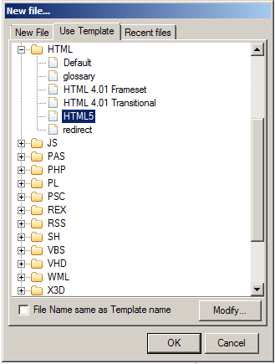
Creating an HTML Document
HTML document consists of text to be displayed and tags
Create a document by hand-coding in a text editor or by using suitable program, we will be using PSPad
Open PSpad
Select File | New File
Select Use Template
Click the + symbol before HTML and select HTML5 and click OK

Slide 19
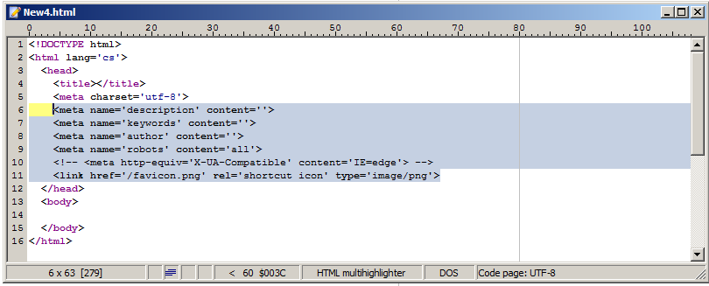
Creating an HTML Document (continued)
Delete the lines 6-11 for the moment, we will look at them later
Change the letters ‘cs’ on line 2 to read en
Add the text First Page between the title tags

Slide 20
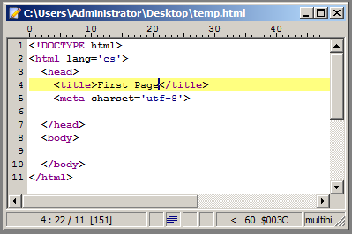
Explain the code
Your page should look like the screen shown

Slide 21
Explain the code
The <!DOCTYPE... > element tells the browser which version of HTML the document is using
It also lets validation software know what version of HTML to validate your code against
The <html> element can be thought of as a container that all other tags sit inside (except for the !DOCTYPE tag)
Takes the lang attribute, which is set to the primary language of the page, in our case en - English
HTML document divided into head and body sections
Head: The <head> tag contains information that is not normally viewable within your browser (such as meta tags, JavaScript and CSS), although the <title> tag is an exception to this
The content of the <title> tag is displayed in the browser's title bar (right at the very top of the browser), more on the title tag later in the course
The meta tag specifies the character encoding used, we will cover this next week
Body: The <body> tag is the main area for your content. Contains elements that are visible in the main window of a Web browser. This is where most of your code will go.
Head and body tags are nested within html tags

Slide 22
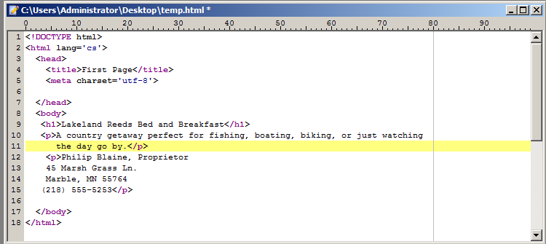
Adding Web Page Text
Type the text for the Web page
Add HTML tags to specify the element type for each text item
<h1> and </h1> : highest level heading
<p> and </p> : paragraph of text

Slide 23
Save your page
Select File | Save As
From the left side of the dialog select where you would like to save your file
Save your file to your X drive
Enter the name FirstPage into the File Name textbox
Click Save

Slide 24
Previewing Your Web Page
Use file manager to open your Web page in one or more browsers
Locate your html file in file manager
Double click the file or
to select a specific browser, right click the file and select open with and choose your browser
Note differences in the way the page is displayed in different browsers
Lunascape
BrowseEmAll
BrowserShots
BroswerStack
BrowserSeal
SauceLabs
IETester
http://www.digitalmarketingservices.ie/how-to-check-if-your-website-is-mobile-friendly/

Slide 25
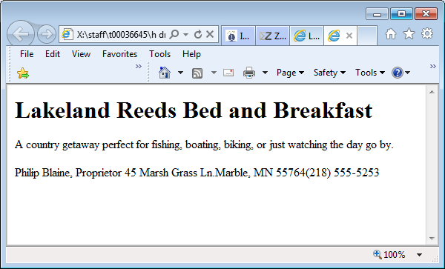
Page output
This is how your page looks when opened within a browser
Any comments??? Does it look as you expected??
Can you fix this??

Slide 26
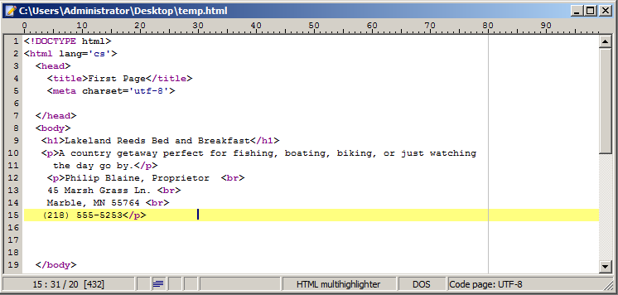
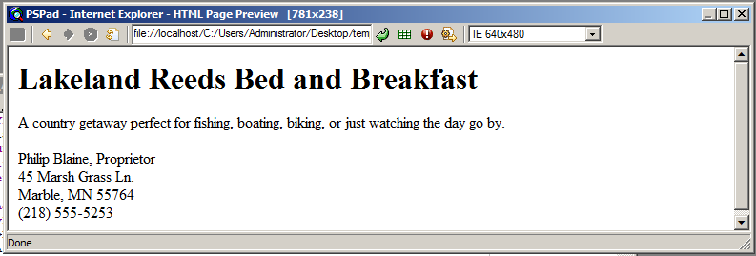

Slide 27
Validating Your HTML Code
Code validation: automated process for comparing your code against HTML5 coding standards
Useful for identifying the source of a specific problem
You can use online tools to validate your code
Validator.w3.org

Slide 28
Working with headings
In addition to the <h1> element, which specifies a top-level heading, HTML supports additional heading elements for lower-level headings from h2 – h6
Browsers commonly display headings in bold with the default serif font using a spectrum of font sizes, with h1 the largest and h6 the smallest
A line space automatically is inserted before and after a heading
Element | Sample formatting
h1 | Heading text
h2 | Heading text
h3 | Heading text
h4 | Heading text
h5 | Heading text
h6 | Heading text

Slide 29
Formatting Elements
Element Name | Formatting style
<p> </p> | Paragraph element Most browsers will automatically insert a double line break (carriage return) around the paragraph element
<br> | Line break (empty element) Used to break up sections of text Causes the browser to create a single line return
<hr> | Horizontal rule (empty element) Used to create a visible horizontal line on a web page

Slide 30
Useful Sites
Webplatform.org
Reference.sitepoint.com
W3schools.com

